Slide 1
The Global Current Affairs Reflective Mind Map
Prof. Roman Gerodimos Faculty of Media and Communication Bournemouth University

Slide 2
A few great pieces of coursework from the 2020/21 cohort

Slide 3
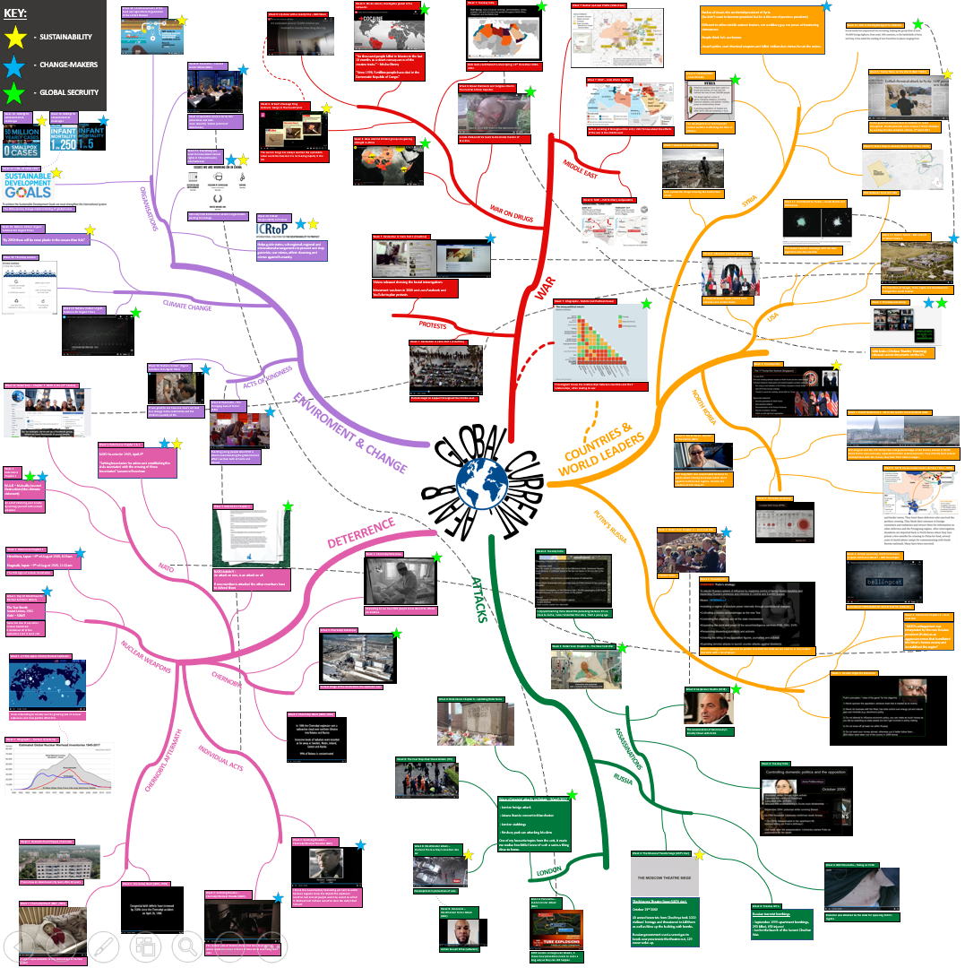
Brad Petrie

Slide 4
Katie Whitney

Slide 5
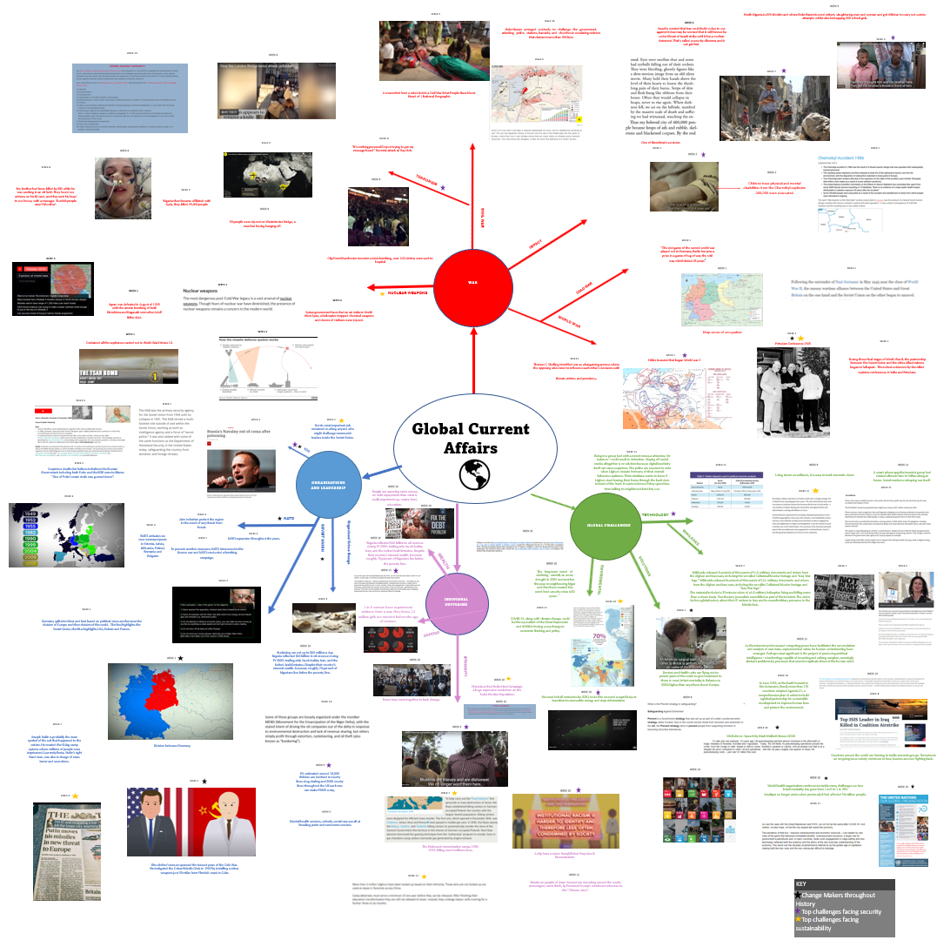
Lauren Porter

Slide 6
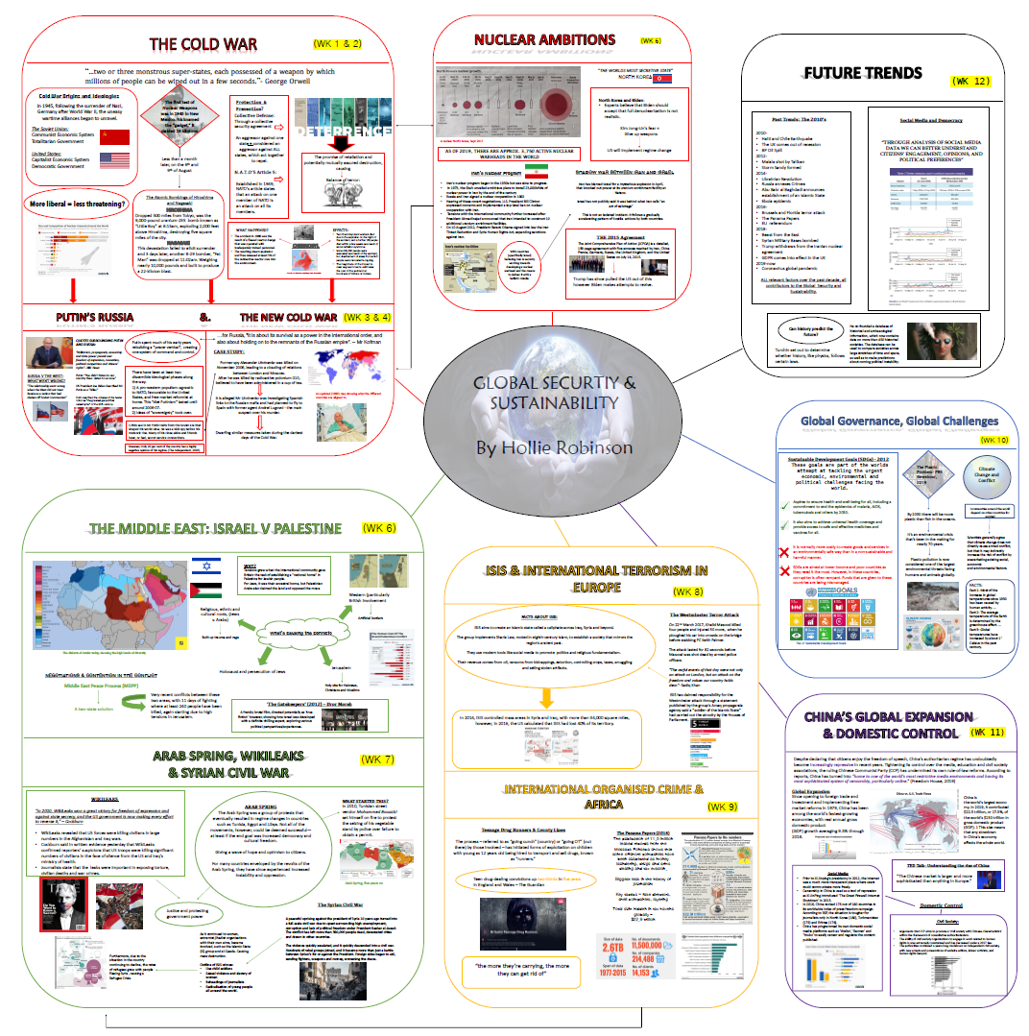
Hollie Robinson

Slide 7
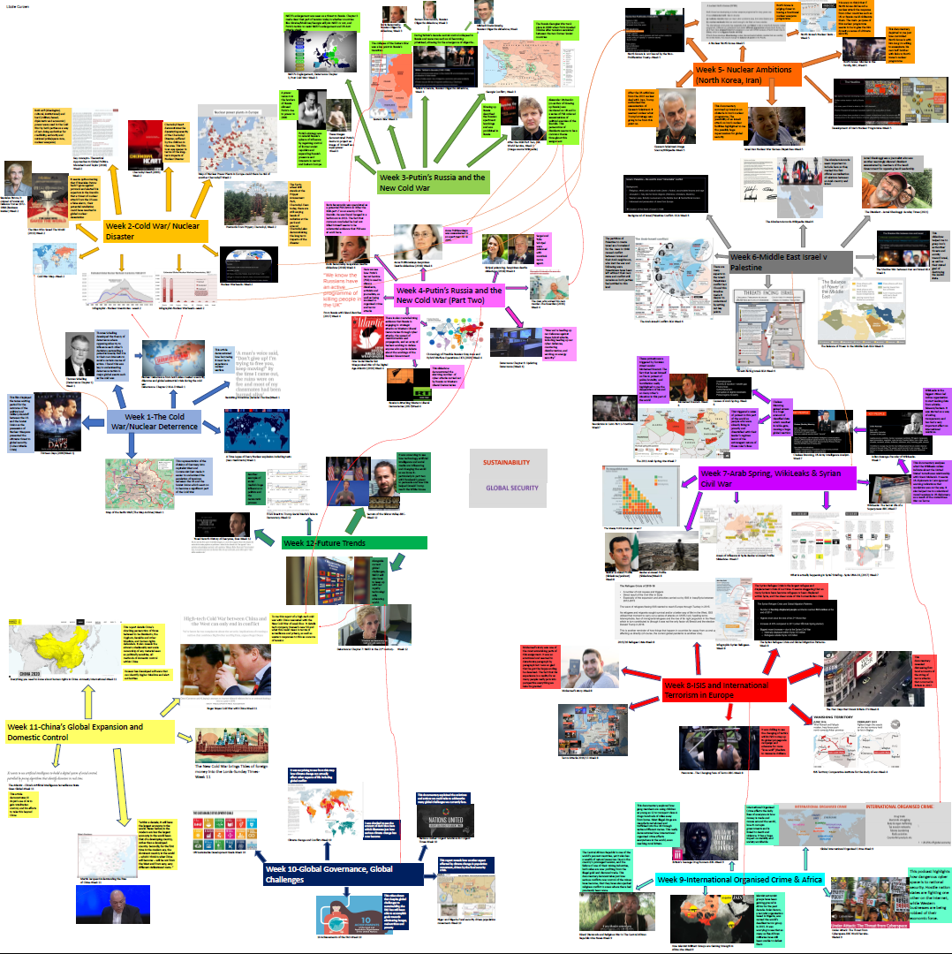
Lizzie Curzen

Slide 8
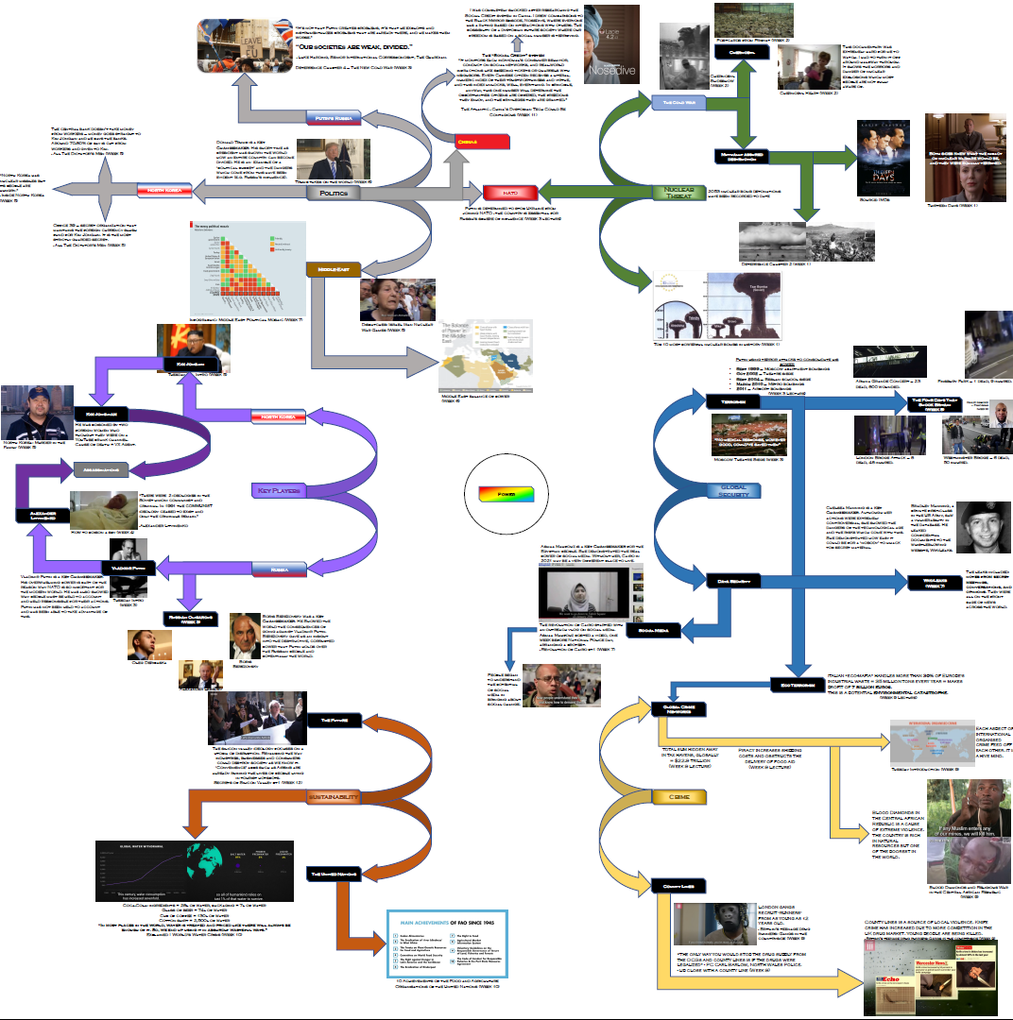
Jordan Elkins

Slide 9
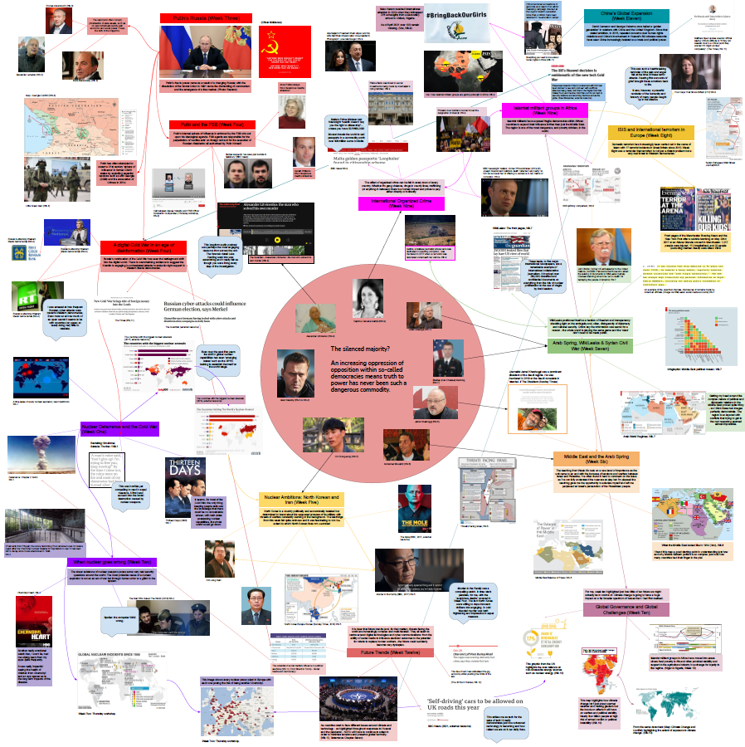
Oliver McManus

Slide 10
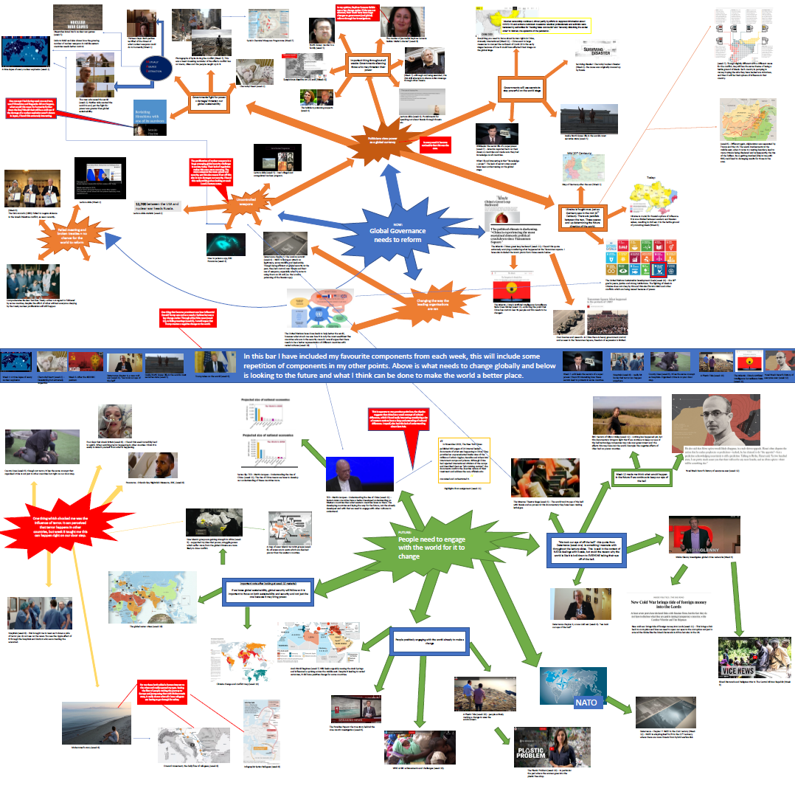
Char Albutt

